Slide 1
COMP1003 – Algorithms, Data Structures & Maths Session 08 Probability and Counting
Thomas Wennekers
University of Plymouth

Slide 2
Overview
Probability
Basic Statistics
Distribution Functions
Counting / Combinatorics

Slide 3
Probability

Slide 4
Probabilities
Suppose we roll a dice N times, and m is the number of occasions you get a 3. If N is large, we’d find that
m ≈ N/6 or m/N ≈ 1/6
As N gets larger and larger, we’d expect that m/N would tend to 1/6
The probability of a 3 is 1/6, since there are 6 equally likely outcomes
Here the event we’re interested in is defined by a single outcome (i.e., the rolling of a 3)

Slide 5
Events
Suppose again that we roll a dice: What’s the probability that the outcome is even?
Here the event we’re interested in is defined by a set of outcomes (i.e., {2,4,6})
Again, the set of all possible outcomes is {1,2,3,4,5,6} … and these are equally likely
Therefore the probability of the outcome being even is 3/6

Slide 6
Events
Suppose again that we roll a dice: What’s the probability that the outcome is > 4?
Here the event we’re interested in is defined by a set of outcomes (i.e., {5,6})
Again, the set of all possible outcomes is {1,2,3,4,5,6} … and these are equally likely
Therefore the probability of the outcome being even is 2/6

Slide 7
Using Venn diagrams
E
set of all possible outcomes
set of outcomes that make
the event E true
If all outcomes are equally likely then
prob(E) =
# outcomes that make E true
# all possible outcomes

Slide 8
Certainty
An event that is certain to happen has a probability of 1
E.g., when rolling a dice, the probability that the outcome will be > 0 is 1
An event that is certain not to happen has a probability of 0
E.g., when rolling a dice, the probability that the outcome will be > 10 is 0

Slide 9
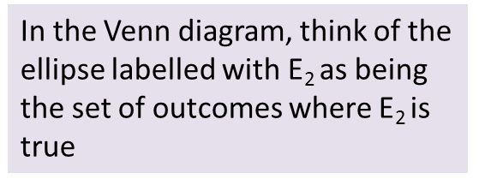
Combining events using “or”
prob(E₁ or E₂) = prob(E₁) + prob(E₂) - prob(E₁ and E₂)
E₁
E₂

Slide 10
Combining events using “or”
Suppose (rolling a dice)
E₁ = “outcome is even”, and
E₂ = “outcome > 4”, then
prob(E₁) = 1/2; prob(E₂) = 1/3
prob(E₁ or E₂) = prob({2,4,5,6}) = 4/6
prob(E₁ and E₂) = prob({6}) = 1/6
prob(E₁ or E₂) = prob(E₁) + prob(E₂) - prob(E₁ and E₂)
4/6 = 1/2 + 1/3 - 1/6

Slide 11
Mutual exclusivity
Two events E₁ and E₂ are mutually exclusive if they cannot both happen together, i.e.,
prob(E₁ and E₂) = 0
in which case
prob(E₁ or E₂) = prob(E₁) + prob(E₂)
E₁
E₂

Slide 12
Mutual exclusivity
When rolling a dice, we cannot simultaneously roll a 1 and a 2
prob(1 or 2) = prob(1) + prob(2) = 1/6 + 1/6 = 1/3
Suppose (rolling a dice)
E₁ = “outcome is even”, and
E₂ = “outcome > 4”, then
prob(E₁) = 1/2; prob(E₂) = 1/3
prob(E₁ or E₂) = 4/6 ≠ prob(E₁) + prob(E₂)
So obviously in this case
not mutually exclusive

Slide 13
Exhaustiveness
Events E₁, E₂, …, E_{n} are exhaustive if
prob(E₁ or E₂ or … or E_{n}) = 1
i.e., it is certain that at least one of the events E₁, E₂, …, E_{n} will occur

Slide 14
Exhaustive and mutually exclusive
If the events E₁, E₂, …, E_{n} are exhaustive and mutually exclusive then
1 = prob(E₁) + prob(E₂) + … + prob(E_{n})
Here it is certain that precisely one of the events E₁, E₂, …, E_{n} will occur

Slide 15
Probability of a negation
1 = prob(E₁) + prob(not E₁)
prob(not E₁) = 1 - prob(E₁)

Slide 16
Conditional probability
prob(E₁│E₂) = the probability of E₁ given E₂
prob(E₁│E₂) = prob(E₁ and E₂) / prob(E₂)
E₁
E₂
Set of outcomes where both are true
I’m not going to bother with the case when prob(E₂)=0

Slide 17
Conditional probability
Suppose (rolling a dice), E₁ = “outcome is even”, and E₂ = “outcome > 4”
prob(E₁│E₂) = prob(even|{5,6}) = 1/2
prob(E₂│E₁) = prob({5,6}|even) = 1/3

Slide 18
Bayes’ theorem “inverts the conditioning”
prob(E₁│E₂) = prob(E₁ and E₂) /prob(E₂)
prob(E₂│E₁) = prob(E₂ and E₁) /prob(E₁)
prob(E₁│E₂) * prob(E₂) = prob(E₂│E₁) * prob(E₁)
prob(E₁│E₂) = prob(E₂│E₁) * prob(E₁) / prob(E₂)
Bayes’ theorem

Slide 19
Bayes’ theorem
Suppose (rolling a dice), E₁ = “outcome is even”, and E₂ = “outcome > 4”
prob(E₁│E₂) = prob(E₂│E₁) * prob(E₁) / prob(E₂)
1/2 = 1/3 * 1/2 / 1/3

Slide 20
Reasoning/diagnostic systems
Suppose
prob(illness) = 0.000002
prob(symptom | illness) = 1
prob(symptom) = 0.1
prob(illness | symptom) =
prob(symptom | illness) * prob(illness) /prob(symptom)
= 1 * 0.000002/0.1 = 0.00002
When the illness is rare and the symptom prevalent in the wider population … the link between the symptom and the illness is very weak

Slide 21
Independent events
Two events E₁ and E₂ are independent if the occurrence of one does not affect the chances of the other
prob(E₁│E₂) = prob(E₁)
prob(E₂│E₁) = prob(E₂)
Each of these statements implies the other – by Bayes’ theorem

Slide 22
Independence
If E₁ and E₂ are independent, then so are (not E₁) and E₂
prob(E₂) = prob(E₂ and E₁) + prob(E₂ and not E₁)
prob(not E₁│E₂) = prob(E₂ and not E₁) /prob(E₂)
= (prob(E₂) - prob(E₁ and E₂))/prob(E₂)
= 1 - prob(E₁ and E₂)/prob(E₂) = 1 – prob(E₁ |E₂)
= 1 – prob(E₁) = prob(not E₁)
ASIDE

Slide 23
Independence Example
Suppose (rolling a dice), E₁ = “outcome is even”, and E₂ = “outcome > 4”, then
prob(E₁│E₂) = prob(even|{5,6}) = ½ = prob(E₁)
prob(E₂│E₁) = prob({5,6}|even) = 1/3 = prob(E₂)
Suppose (rolling a dice), E₁ = “outcome is even”, and E₂ = “outcome > 3”, then
prob(E₁│E₂) = 2/3 ≠ prob(E₁)
prob(E₂│E₁) = 2/3 ≠ prob(E₂)
independent
not independent

Slide 24
Combining independent events
If E₁ and E₂ are independent, then
prob(E₁ and E₂) = prob(E₁│E₂) * prob(E₂)
= prob(E₁) * prob(E₂)
Suppose (rolling a dice), E₁ = “outcome is even”, and E₂ = “outcome > 4”, then
prob(E₁ and E₂) = prob(6) = 1/6
prob(E₁) = 1/2
prob(E₂) = 1/3
prob(E₁) * prob(E₂) = 1/2 * 1/3 = 1/6
We’ve already seen that these are independent

Slide 25
Distributions Functions

Slide 26
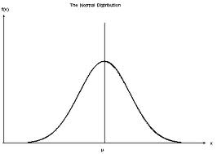
Probability distributions
When rolling a dice there are a finite number of possible outcomes.
Often, however, we have an “infinite” number of possible outcomes. For example the distribution of people’s heights might look like this:
The probability that a randomly chosen person will have height between a and b is the area under the graph between x=a and x=b.
The normal distribution
h(x) = α exp(-β(x-μ)²)
x
μ

Slide 27
Example: Probability distributions
Measurements are never perfectly accurate, and therefore we might say that a person’s height is 1.7 ± 0.005 m.
The slice has width 0.01m = 1cm
The probability that someone’s height is in this range is the area under the graph between 1.695 and 1.705 … which (since the slice is very thin) is approximately equal to h(1.7) * 0.01
h(x)
The width of the slice
1.705
1.695

Slide 28
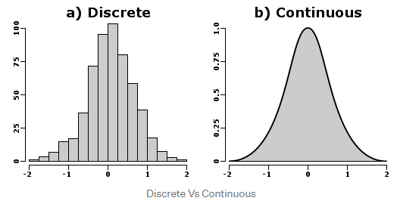
Probability Distributions
The continuous case is also called Probability distribution function

Slide 29
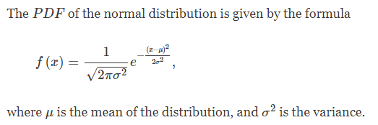
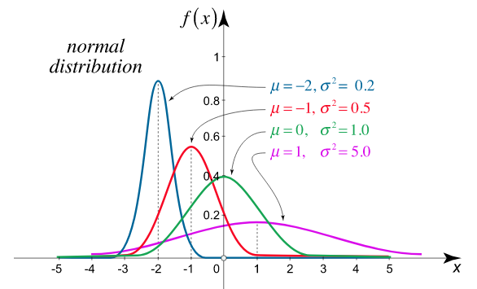
Some Common Distributions Normal or Gaussian Distribution

Slide 30
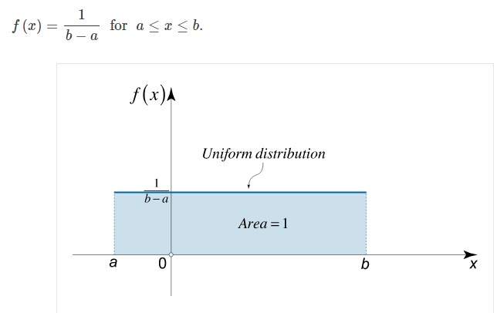
Some Common Distributions Uniform or Equi-Distribution

Slide 31
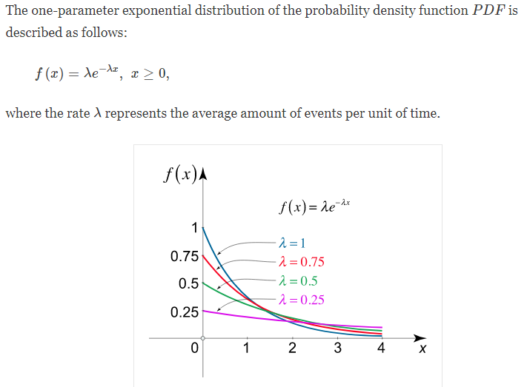
Some Common Distributions Exponential Distribution (eg. how quickly break things?)

Slide 32
Basic Statistics

Slide 33
Basic Statistics
Statistics analyses or describes data
Expected value and Empirical Mean
Standard deviation and Variance
Law of Large Numbers (LLN)
Central Limit Theorem

Slide 34

Expected Value and Mean
Consider a fair dice
6 equi-probable options, X = {1,..6}, p=1/6
The expected value E(X) is the empirical mean of an (infinitely) large number of tosses
Mean =

Slide 35

Expected Value and Mean
Consider a fair dice
6 equi-probable options, X = {1,..6}, p=1/6
The expected value E(X) is the empirical mean of an (infinitely) large number of tosses
E(x) can be computed from the (equi-)distribution

Slide 36
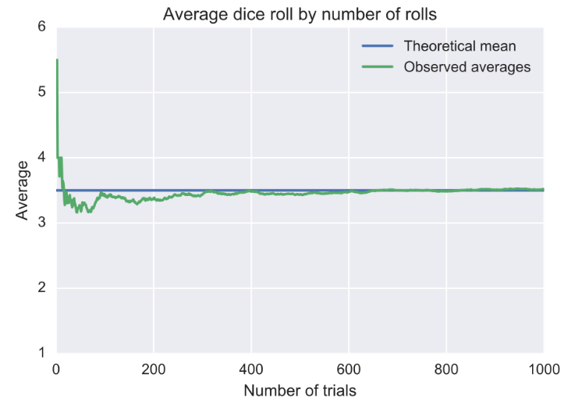
Observation: Law of Large Numbers
Empirical mean converges towards Expected Value

Slide 37
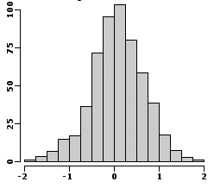
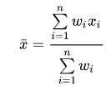
Expected Value as Weighted Mean Discrete Distribution
Each outcome must be weighed by it’s own probability
The weights are the counts per bin

Slide 38
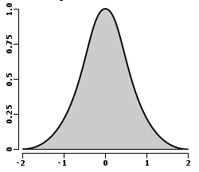
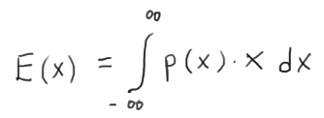
Expected Value as Weighted Mean Continuous Distribution
Each outcome must be weighed by it’s own probability
Sum replaced by integration over all possibilities
p(x) normalised to have integral 1

Slide 39
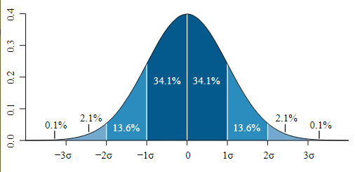
Standard Deviation
Standard deviation, “sigma”, is a measure for the variation of data (around the mean)

Slide 40
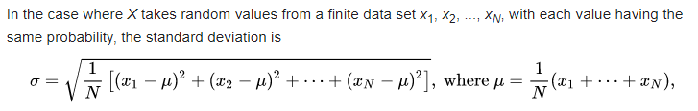
Standard Deviation
mu is the mean
x_{i} – mu is the difference of x_{i} from mu
(x_{i} – mu) is the squared difference
sigma is the root of the mean of the squares

Slide 41
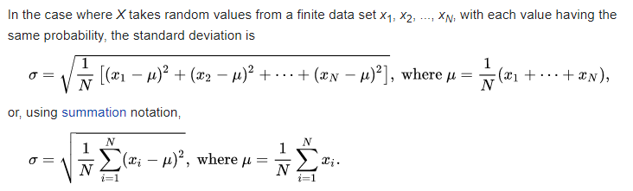
Standard Deviation

Slide 42

Standard Deviation
In the weighted case:

Slide 43
Variance
sigma² is often called variance
For independent random variables the variance is additive (but not sigma)
Var( X+Y ) = Var(X²) + Var(Y²)

Slide 44
Back to the Law of Large Numbers
Empirical mean converges towards Expected Value

Slide 45

Law of Large Numbers
For n independent random variables with E(X)=mu and finite variance sigma²
Consider the empirical mean
Law of Large Numbers:

Slide 46
Law of Large Numbers
For n independent random variables with E(X)=mu and finite variance sigma²
Consider the empirical mean
Law of Large Numbers
“Proof”:
the latter goes to zero asymptotically if n goes to infinity

Slide 47
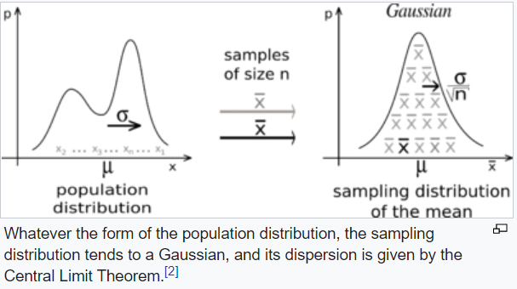

Central Limit Theorem

Slide 48
Counting / Combinatorics

Slide 49
Counting
count the number of elements of a finite set
obviously important to compute probabilities
Combinatorics
similar to counting, but wider range of contexts
construct elements or configurations of a set given some specs
also used in optimisation

Slide 50
Counting
A = {x| x in N, x < n, x odd} ; |A| = ?
Any set A with |A| = n ; |P(A)| = ?
How many possible ways to get up a staircase with n steps, if you can do only 1 or 2 at a time?

Slide 51
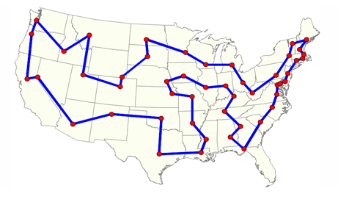
Traveling Salesman Problem
How many different ways to visit N cities in a round trip not visiting any city twice?
How complex is it to compute the shortest trip?

Slide 52
Traveling Salesman Problem
How many different ways to visit N cities in a round trip not visiting any city twice?
How complex is it to compute the shortest trip?
N possibilities for the first city
N-1 for the second ; N-2 for the next ; etc.
In total: N*(N-1)*(N-2)*…..*2*1 = N!

Slide 53
Permutations
How many ways to arrange N different numbers?
Same as Traveling Salesman Problem: N!

Slide 54
How many heads in N fair coin tosses?

Slide 55
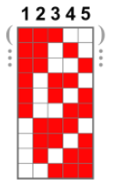
Bernoulli Trials / Binomial Experiment
How many heads in N fair coin tosses?
Obviously between 0 and N
Better question: what’s the probability to see k heads in N fair coin tosses?
Count possibilities; order does not matter
aka combinations

Slide 56
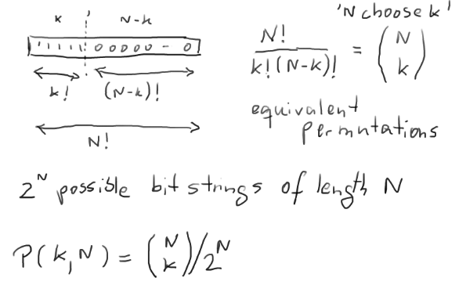

Slide 57

Bernoulli Trials / Binomial Experiment
More generally p = P(odd) != P(even) = q
Binomial distribution
Previous case p=q=1/2

Slide 58
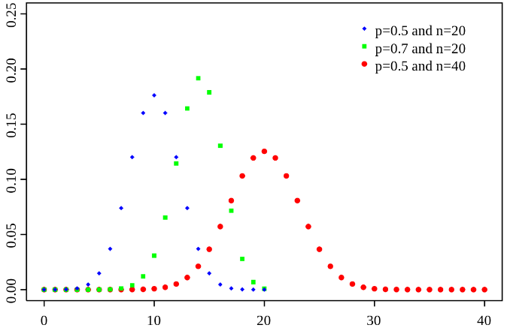
Bernoulli Trials / Binomial Experiment
More generally p = P(odd) != P(even) = q
Binomial distribution

Slide 59
Summary
Probability is build on set theory
It measures how likely events occur
Statistics describes data and their distributions
Combinatorics helps to count possibilities in discrete structures
Combinatorics helps to characterize complexity of problems and code → later sessions

